Slide 1
Reducing Defect Density of NDB
Function/Process | NDB-Dev | Project Name | Reduce the Defect Density of NDB
Start Date | 20-Mar-13 | End Date | 30-Oct-13
Project Champion | Satishkumar Dontamsetty | Project Sponsor | Mukesh Jain
Project Leader (GB) | Tejas Pancholi | Coach (BB/MBB) | Anshika Agarwal/SVSN Murthy
Business case: Based on the Quality reports published by QPI team, it was observed that the defect density in the NDB application is high and its impacting the cost of the quality and delivery schedule . The objective of this Initiative is to reduce the defect density for NDB application.
Problem Statement: As per Q1 2012 to Q1 2013 data, average defect density is 1.49 defects/Person Month which is above the organizational average of 0.65 defects/Person Month. High defect density leads to high development cost and impacts delivery schedule.
Goal Statement: Goal is to decrease the defect density from 0.96 defects/Person Month to 0.60defects/Person Month by 30th Oct, 2013.
Project Scope:
In Scope:- All value added defects reported in the quality center.
All SPRF which have at least estimated total effort of 100 Plan View Hours.
Process Start Point : Receipt of Design document
Process End Point : Sign off from business
Out-of-Scope:- Defect related to test region ABENDS and non value added defects will not be part of the project.
Post deployment defect can not be included in the scope as effort source not available.
Projected Benefits:
Effort saving of 2592 hours/annum worth $199,584.
Delivery on Schedule
Less Rework effort
Reduction in cost of Quality(COQ)
D
M
A
I
C

Slide 2
Project Charter
ARMI
Member Name | Role | Define | Measure | Analyze | Improve | Control
Satishkumar Dontamsetty | Off Shore Champion | A | A | A | A | A
Bruno Nicole | Onshore Champion | A | A | A | A | A
Mukesh Jain | Sponsor | I | I | I | I | I
Bruce Grey | Onshore Sponsor | I | I | I | I | I
SVSN Murthy | Master Black Belt | A | A | A | A | A
Anshika Agarwal | Black Belt | M | M | M | M | M
Raj Zaladanki | SME | R | R | R | R | R
Tejas Pancholi | Project Lead | M | M | M | M | M
Sashi Pandey | SME | I | R | R | R | I
Rajanala Hari P | SME | R | R | R | R | R
A -Approver
R -Resource
M -Member
I -Interested Party
Sign - offs
Champion | Satishkumar Dontamsetty
Quality Leader | SVSN Murthy
D
M
A
I
C

Slide 3
Project Charter
Project Milestone :
Phase | Target |  |  |  |  | Actual
Define | 20th Mar 13 – 10st Apr 13 |  |  |  |  | 08 May 13
Measure |  | 11th Apr 13 – 25th Apr 13
Analyze |  |  | 26th Apr13 – 24th Jun 13
Improve |  |  |  | 25th Jun 13 -18th Sep 13
Control |  |  |  |  | 19th Sep 13 – 30th Oct 1315
D
M
A
I
C

Slide 4
Saving Calculations
Label | Numbers | Unit | Remark
Current defect Density | 0.96 | Defect/Person month
Proposed defect density | 0.6 | Defect/Person month
Difference in defect density | 0.36 | Defect/Person month
Defects saved per month | 54 | Number | (0.36 defect/person month * 150)
Defects saved per annum | 648 | Number
No. of hours to resolve 1 defect | 4 | Hours | This need to be validated during current releases
Effort saved by reduction in defect density | 2592 | Hours
Total Saving | $199,584 | Dollar | Assumption $77 rate per hour

Slide 5
SIPOC
Supplier
Input
Process
Output
Customer
NDB SA
Design Document
Design Document
Review
Updated Design
Document
NDB QA
Request Traceability
Matrix update
Updated
Request Traceability
Matrix
Various UHG Systems
(ie COSMOS, TOPS,UFE)
Request Traceability
Matrix
Coding
New/Updated Code
Code Review
Review log
Code Movement
New/Enhanced
Application

Slide 6
VOC Table
Voice Of Customer | CTQ | Goal
“Defect Density for NDB application was high in the year 2012. This meant more effort were spent on rework and redesign. This also impacts the overall quality of the deliverable and the delivery schedule” | Number of value add defects | Goal is to decrease the defect density from 0.96 defects/person month to 0.60 defects/person month.
D
M
A
I
C

Slide 7
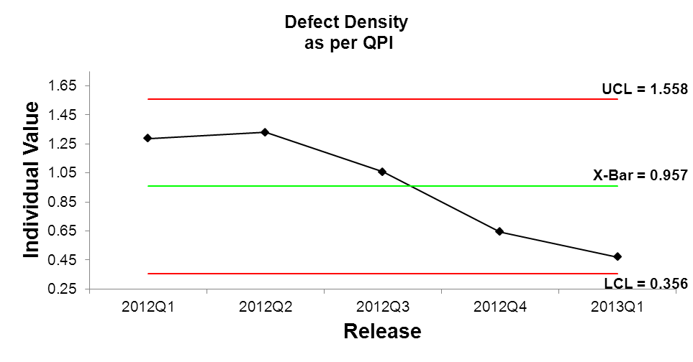
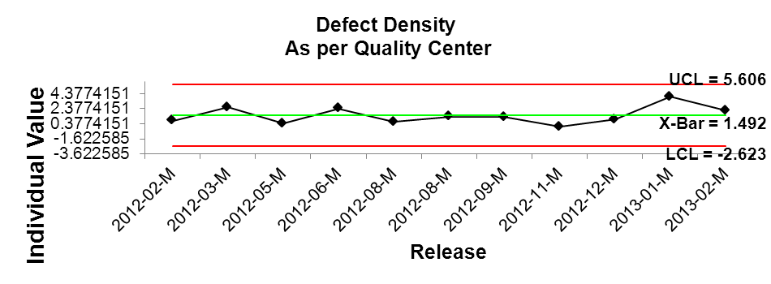
Data Accuracy Check
Tricare data is not included
PRA contains snapshot of defect data till a certain date, any changes after that does not get reflected.
Non Integrated release data is not available in PRA

Slide 8
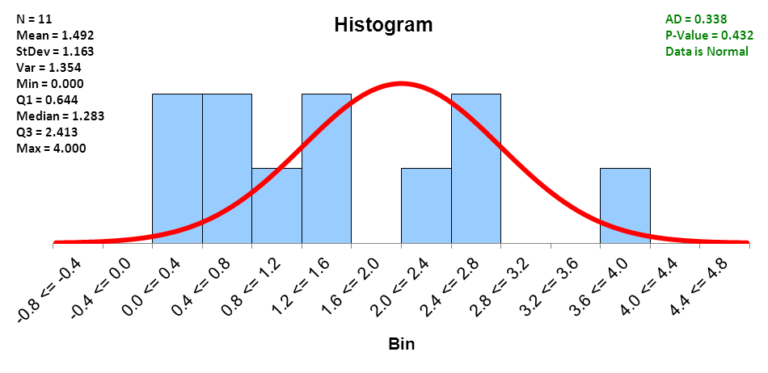
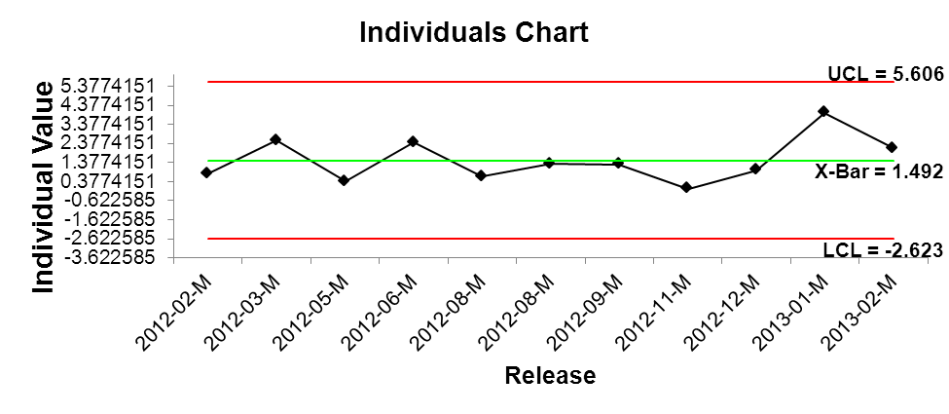
Current Base Line
Findings
Current Avg. Defect Density = 1.49 Defect/Person Month
Defect Density is varying from 0 to 4
Next Step
Identify reason for huge variance and reduce it.

Slide 9
Annexure 1 Detail Flow Diagram
START
A
Attend QCA walk thru
Receive email about Allocation of work
Code moved to Repository available for testing
Review spec from ADR
Defect comes
Attend SA spec walkthrough,
CICS-DB2
ONLY DB2
ONLY CICS
Submit ITG for table, Tran id and submit form for foundation entry
Submit ITG for table generation
Submit ITG for Tran id creation and submit for form foundation entry
Verify if defect is correct
Complete coding,
Doubts cleared thru email during the process
Correct code, if change required
A

Slide 10
Annexure 2 Low hanging fruit identified
START
A
Allocation of work and Reviewer not done in the earlier life cycle
Impact analysis missing when resolving defects
Receive email about Allocation of work
Attend QCA walk thru
Spec review not done before attending walkthrough
LLD is missing
Code moved to Repository available for testing
Review spec from ADR
Dev and QCA attend walkthrough separately
Design understanding is missing
Defect comes
Attend SA spec walkthrough,
CICS-DB2
ONLY DB2
ONLY CICS
Submit ITG for table, Tran id and submit form for foundation entry
Submit ITG for table generation
Submit ITG for Tran id creation and submit for form foundation entry
Verify if defect is correct
Missing Proper unit testing or code review
Usage of RTM missing
Coding standards not followed
Impact analysis not done
No proper communication mechanism to clarify doubts
Complete coding,
Doubts cleared thru email during the process
Correct code, if change required
A

Slide 11
Annexure 3 Proposed solution for low hanging fruits
START
A
Conduct Unit testing for all impacted component should be done after each defect fix
Allocation of developer and Peer reviewer
Attend QCA walk thru
Receive email about Allocation of work
Code moved to Repository available for testing
Creation of Query log
LLD has to be created
Review spec from ADR
Defect comes
Dev and QCA should attend Walkthrough together
LLD walkthrough should be conducted for QA, SA team
Attend SA spec walkthrough,
CICS-DB2
ONLY DB2
ONLY CICS
Submit ITG for table, Tran id and submit form for foundation entry
Submit ITG for table generation
Submit ITG for Tran id creation and submit for form foundation entry
Verify if defect is correct
HLTO Review
Development related entry in RTM
UTP and code review
Impact analysis should be carried out in all stages when change is done to code/UTP/RTM
Usage of query log
Complete coding,
Doubts cleared thru email during the process
Correct code, if change required
A

Slide 12
Assumption
We will be taking release as per QC and not as per Plainview
PM ticket(within 60 days warranty period) will be considered as 1 defect.
It may be possible defect was logged in 1 release but it may really be of some other release(i.e. PM tickets)

Slide 13
Gaps in PRA data
Tricare data is not included
PRA data doesn’t reflect actual count
Non Integrated release data is not available in PRA
Post deployment defect can not be included in the scope as effort source not available.

